Slide 1
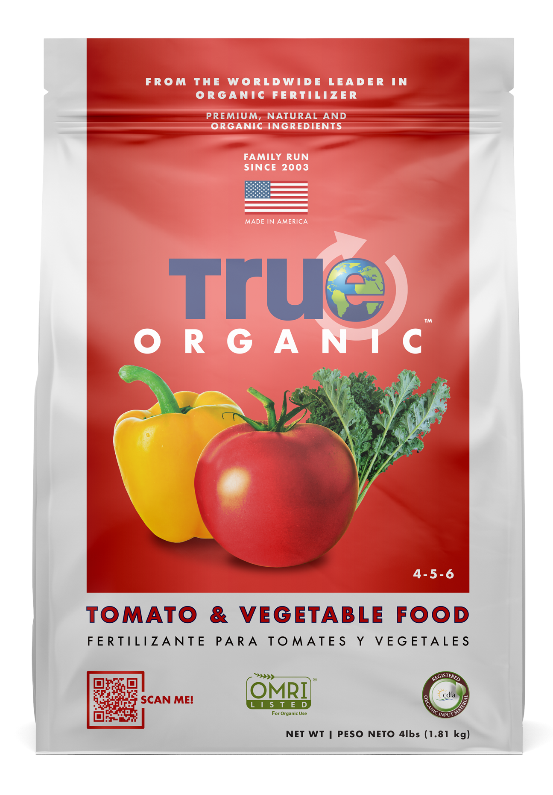
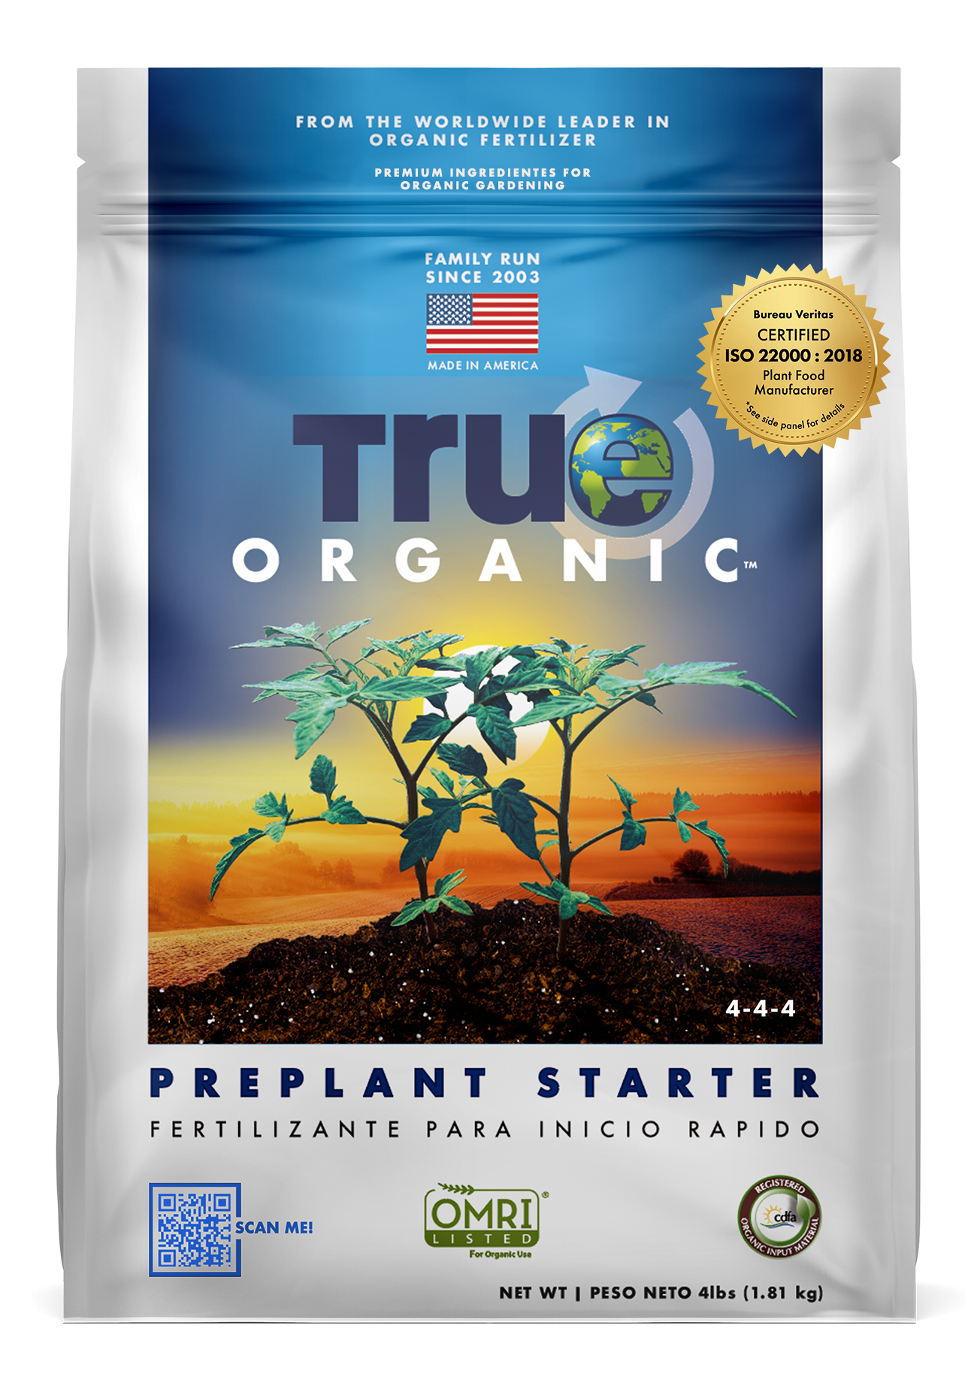
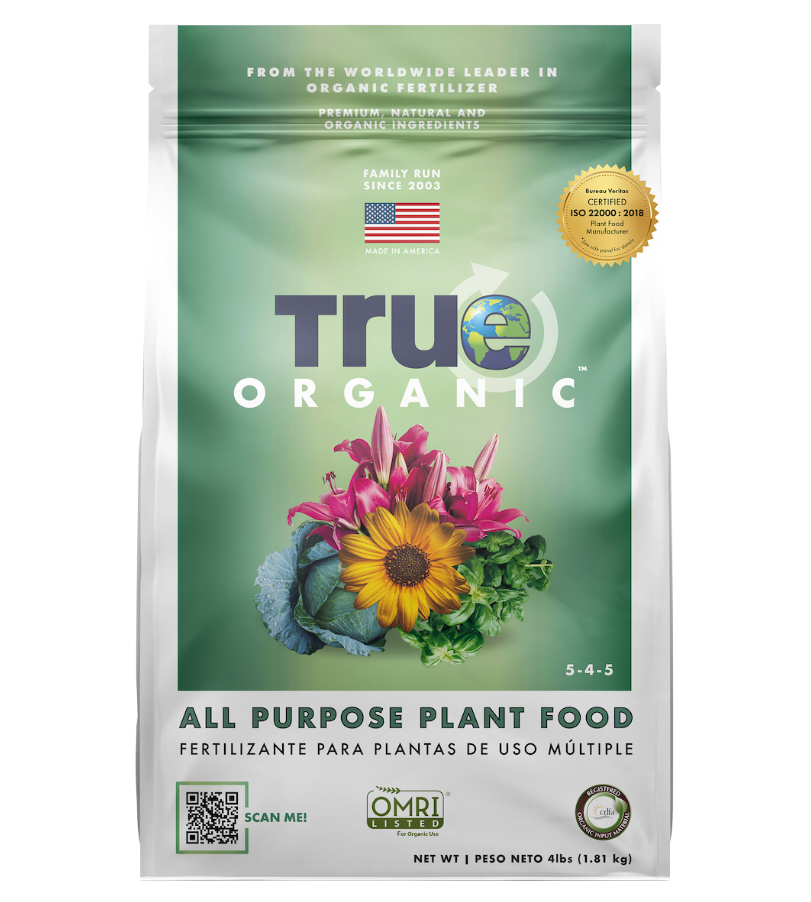
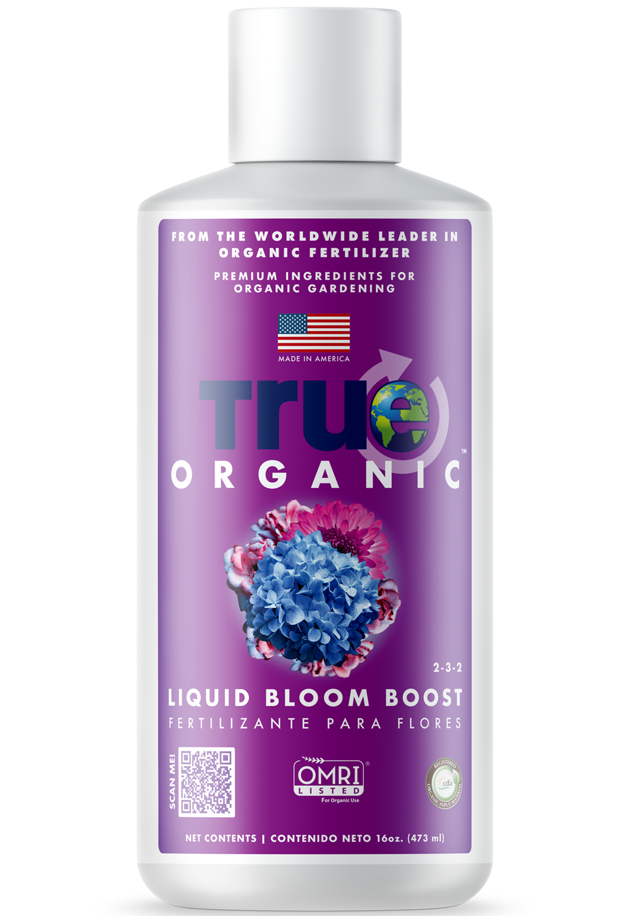
BUY ANY TRUE ORGANIC DRY PLANT FOOD AND GET A FREE… TRUE ORGANIC LIQUID BLOOM BOOST 16oz
BUY ME
& GET ME
FREE
SEE STORE FOR DETAILS

